Slide 1
Topic: Congruency EQ: What is a tessellation?

Slide 2
5 Questions
Topic: Congruency
EQ: What is a tessellation?
What transformation shifts a shape up or down?
Calculate 11% of $33
Give 3 real-life examples of rates
Simplify 90:15
5. Complete your summary from last lesson.

Slide 3
TASK
Name the following shapes below:
1)
2)
3)
4)
5)
RHOMBUS
PARALLELOGRAM
ISOSCELES
TRIANGLE
PENTAGON
ISOSCELES
TRAPEZIUM
6)
7)
8)
9)
10)
HEXAGON
HEPTAGON
OCTAGON
DECAGON
DODECAGON
EXTENSION
Sketch and name as many solids (3D shapes) as you can.
Notes:
3

Slide 4
What on Earth is Tessellation?
A tessellation is created when a shape is repeated over and over again covering an area without any gaps or overlaps.

Slide 5
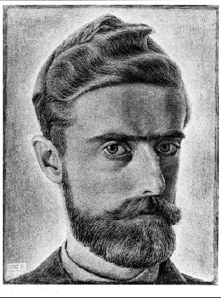
So who is this Escher guy?
Maurits Cornelis Escher, usually referred to as M. C. Escher, was a Dutch graphic artist. He is known for his often mathematically inspired tessellations.
Let’s take a look at some of his work…

Slide 6
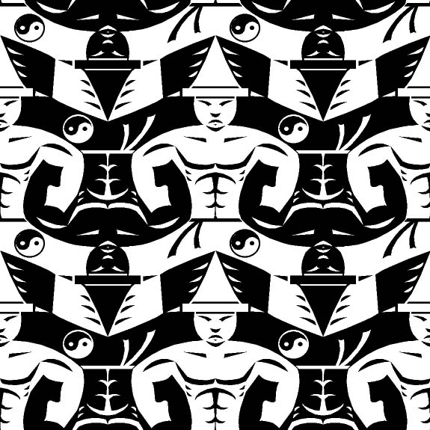

Slide 7
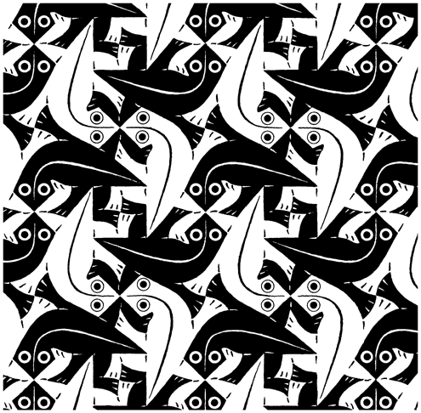

Slide 8
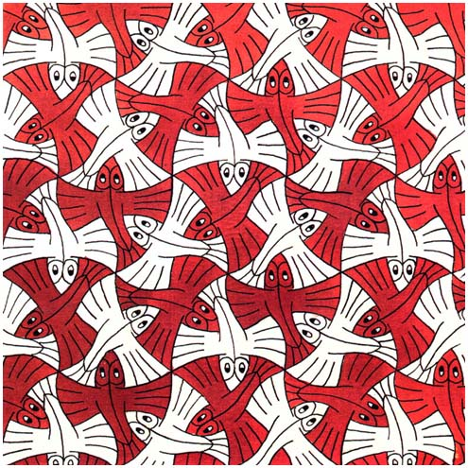

Slide 9
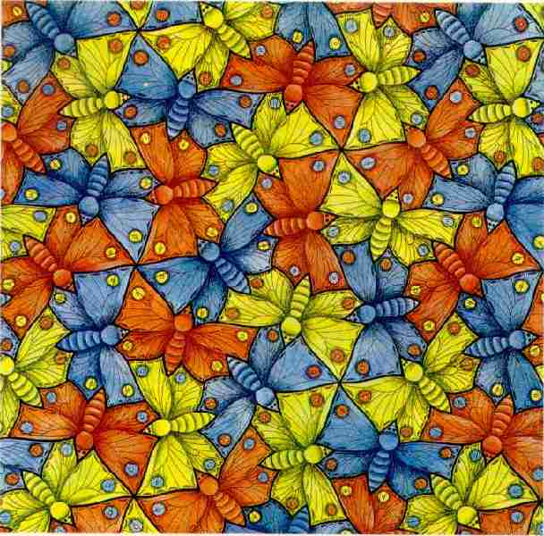

Slide 10
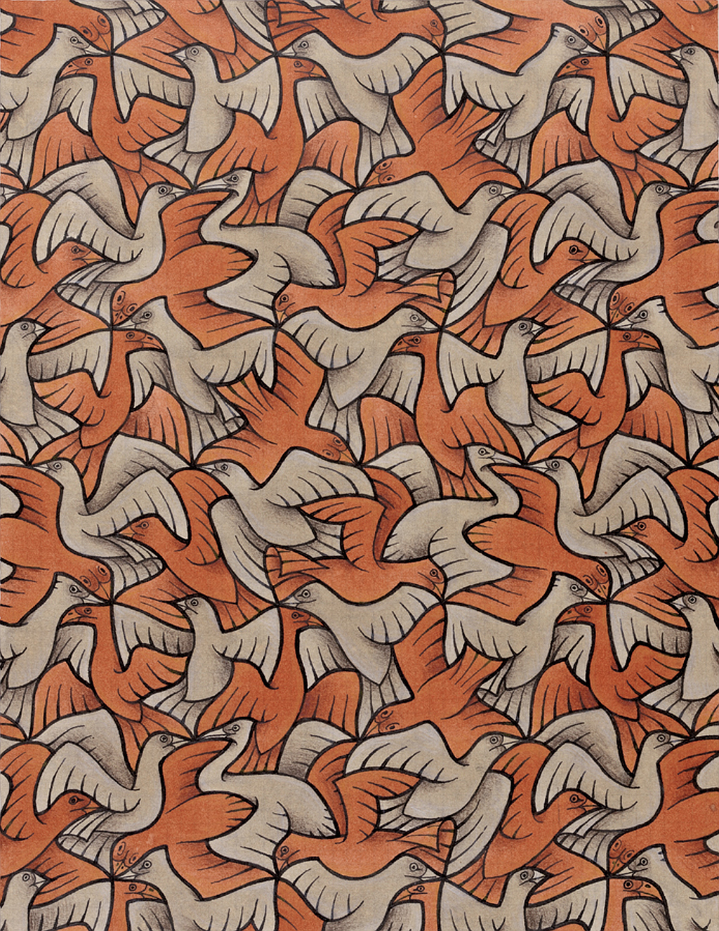

Slide 11
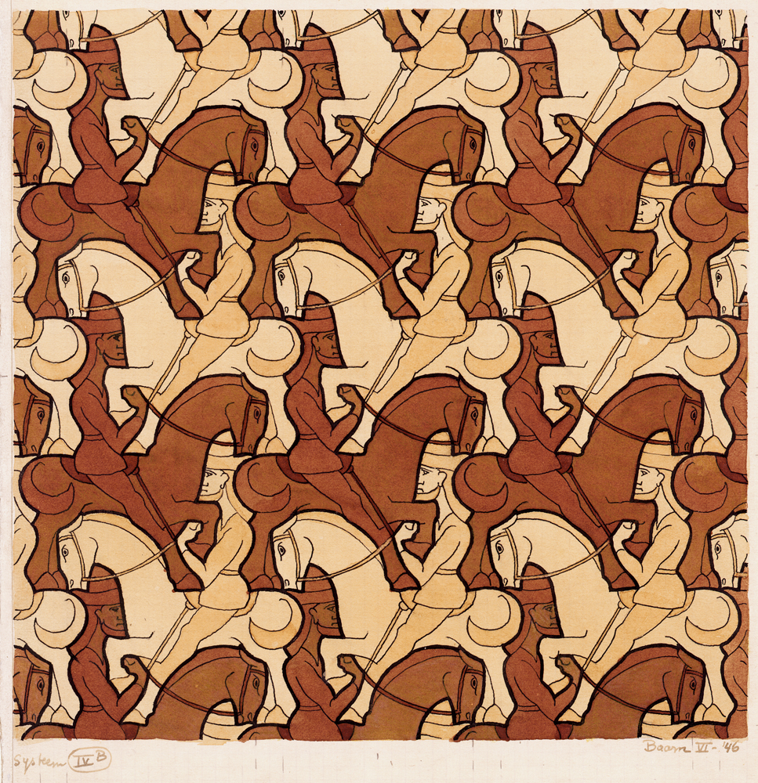

Slide 12
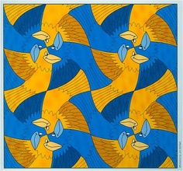

Slide 13


Slide 14
Where do we see tessellation in everyday life?

Slide 15

Corn on the cob

Slide 16
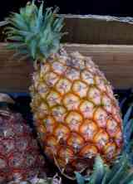
Pineapple

Slide 17
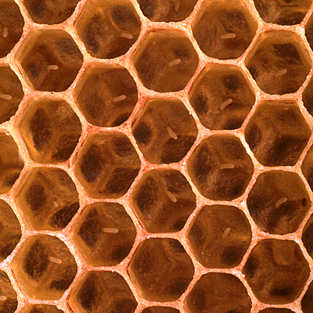
Honeycomb

Slide 18
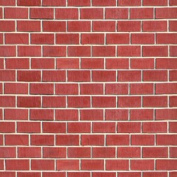
Brick Laying

Slide 19
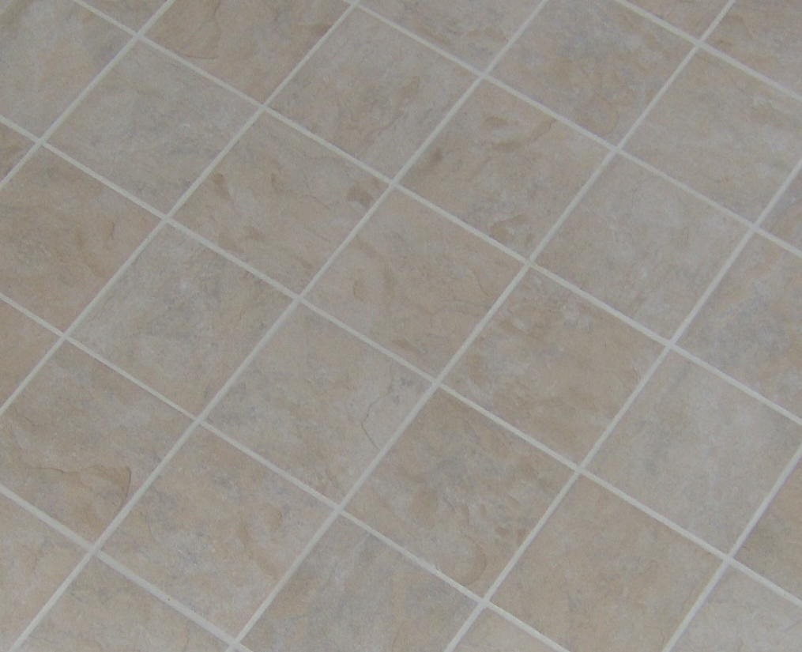
Floor Tiles

Slide 20
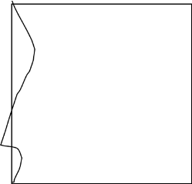
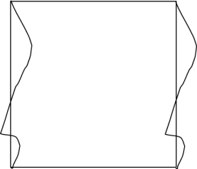
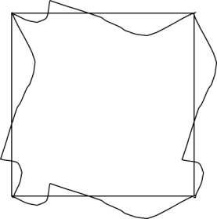

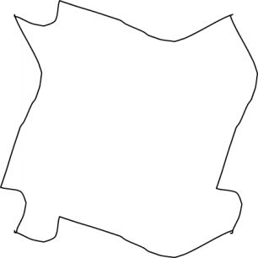
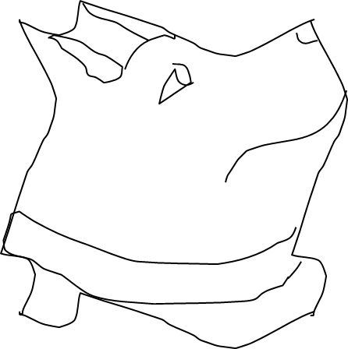
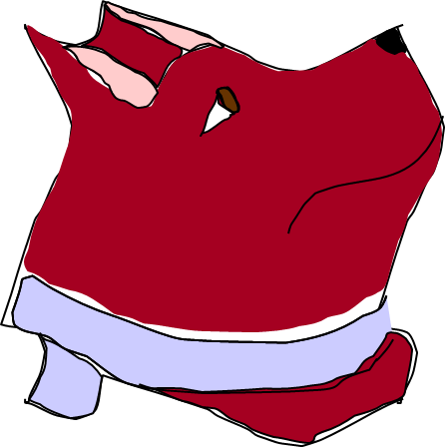
TESSELLATIONS
HOW TO MAKE AN ESCHERESQUE TESSELLATION
STEP 1
STEP 2
STEP 3
STEP 4
Begin with a simple shape
Change the shape of one side
Copy this line on the opposite side
Rotate the line and repeat it on the remaining edges
STEP 5
STEP 6
STEP 7
Erase the original shape (square)
Add lines inside the shape to make a picture
Add colour to enhance your picture
Notes:
20

Slide 21
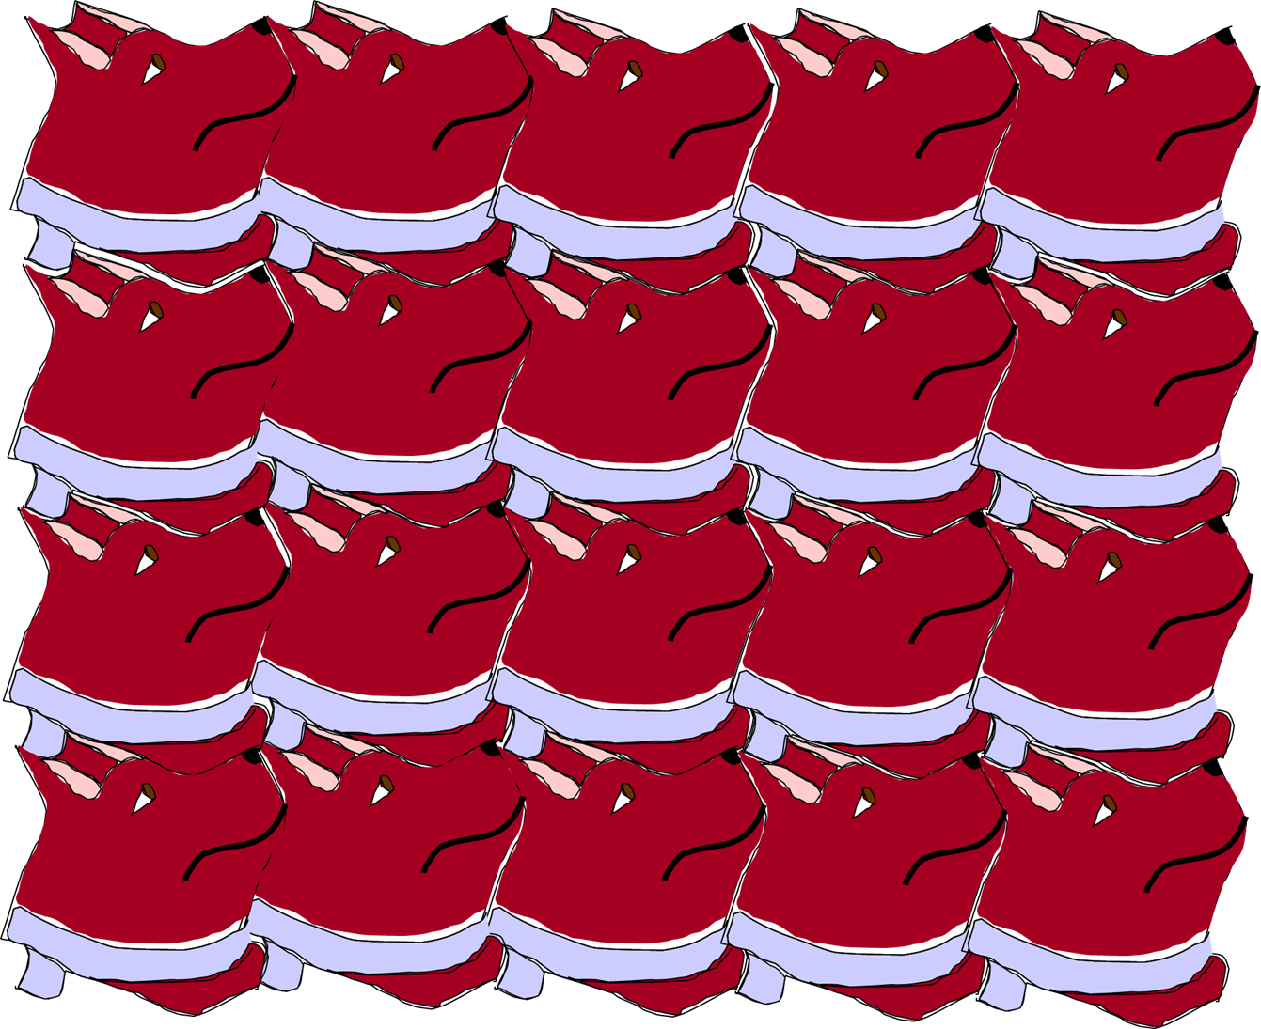
TESSELLATIONS
HOW TO MAKE AN ESCHERESQUE TESSELLATION
Notes:
21

Slide 22
TESSELLATIONS
EXAMPLES
1)
TASK
Show that the kite tessellates by drawing on at least six more kites on the grid.
Notes:
22

Slide 23
TESSELLATIONS
EXAMPLES
2)
TASK
Show that the hexagon tessellates by drawing on at least six more hexagons on the grid.
Notes:
23

Slide 24
TESSELLATIONS
EXAMPLES
3)
TASK
Show that the trapezium tessellates by drawing on at least eight more trapezia on the grid.
Notes:
24

Slide 25
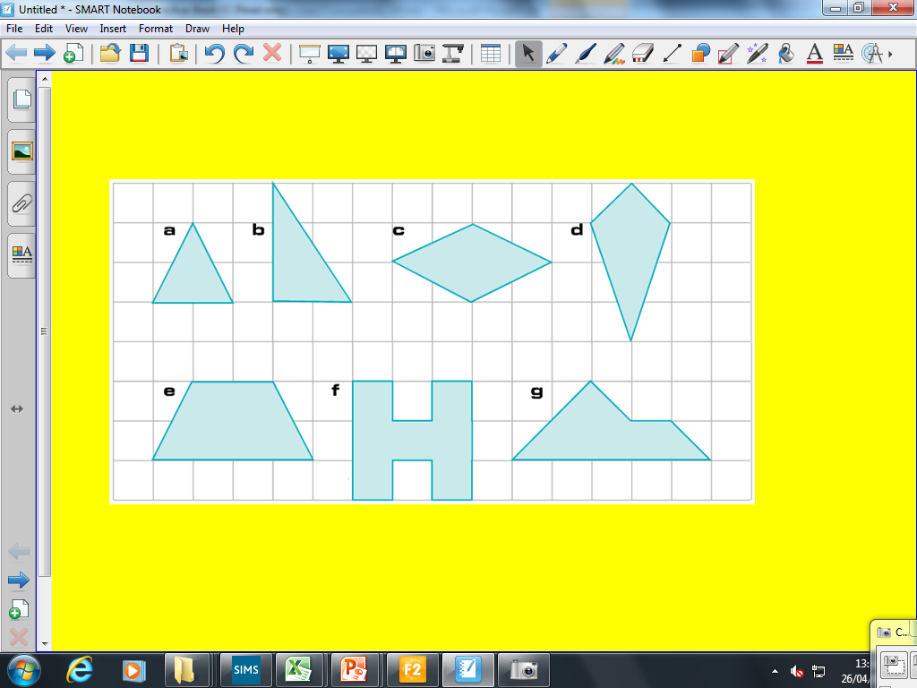
TESSELLATIONS
TASK
1) On squared paper show how each of these shapes tessellate:
EXTENSION (GRADE D)
1) Explain why equilateral triangles, squares and regular hexagons tessellate.
2) Develop your own Escheresque tessellations.
Notes:
25

Slide 26
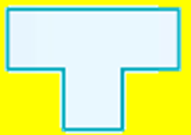
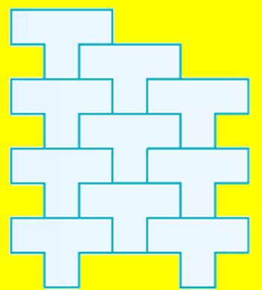
TESSELLATIONS
Draw the tessellation of the shape below:
Notes:
26

